Slide 1
Multidimensional Gradient Methods in Optimization
by
Dr. Md. Rajibul Islam
CSE, UAP

Slide 2
Steepest Ascent/Descent Method

Slide 3
Multidimensional Gradient Methods -Overview
Use information from the derivatives of the optimization function to guide the search
Finds solutions quicker compared with direct search methods
A good initial estimate of the solution is required
The objective function needs to be differentiable

Slide 4
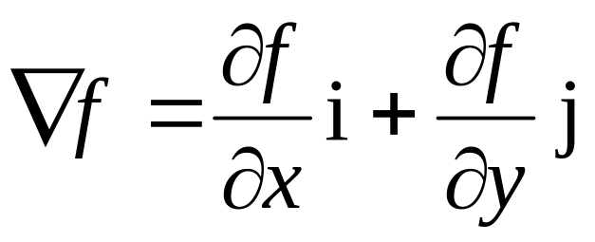
Gradients
The gradient is a vector operator denoted by ∇ (referred to as “del”)
When applied to a function , it represents the functions directional derivatives
The gradient is the special case where the direction of the gradient is the direction of most or the steepest ascent/descent
The gradient is calculated by

Slide 5

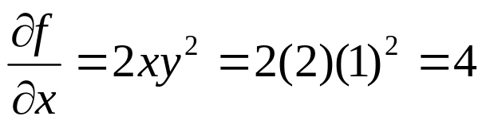
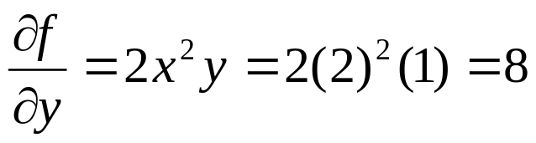
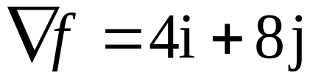
Gradients-Example
Calculate the gradient to determine the direction of the steepest slope at point (2, 1) for the function
Solution: To calculate the gradient we would need to calculate
which are used to determine the gradient at point (2,1) as

Slide 6
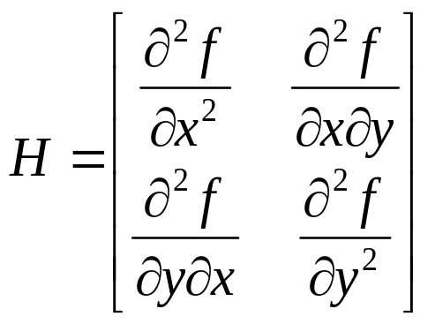
Hessians
The Hessian matrix or just the Hessian is the Jacobian matrix of second-order partial derivatives of a function.
The determinant of the Hessian matrix is also referred to as the Hessian.
For a two dimensional function the Hessian matrix is simply

Slide 7
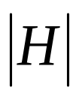
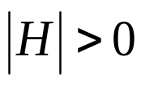



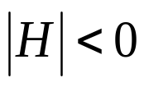
Hessians cont.
The determinant of the Hessian matrix denoted by can have three cases:
If and then has a local minimum.
If and then has a local maximum.
If then has a saddle point.

Slide 8
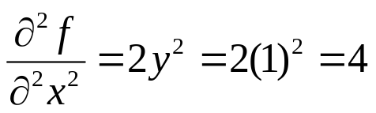
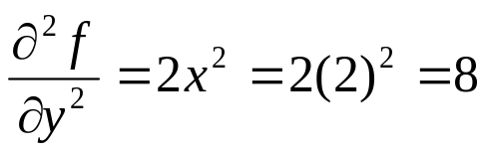
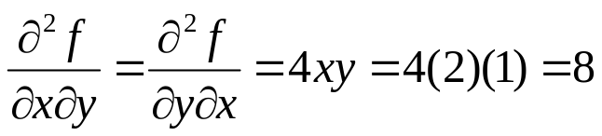
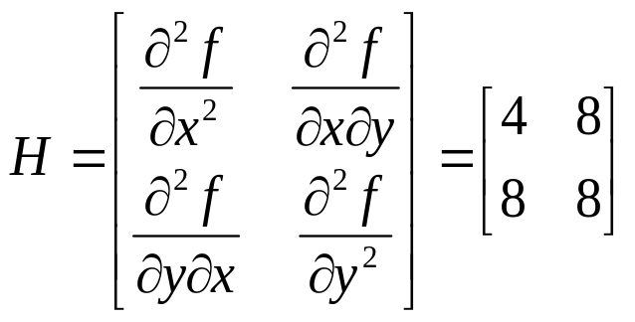
Hessians-Example
Calculate the hessian matrix at point (2, 1) for the function
Solution: To calculate the Hessian matrix; the partial derivatives must be evaluated as
resulting in the Hessian matrix

Slide 9
Steepest Ascent/Descent Method
Starts from an initial point and looks for a local optimal solution along a gradient.
The gradient at the initial solution is calculated.
A new solution is found at the local optimum along the gradient
The subsequent iterations involve using the local optima along the new gradient as the initial point.

Slide 10
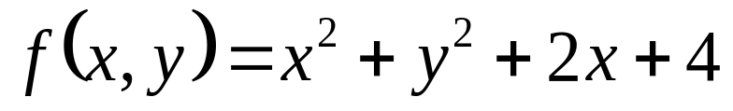
Example
Determine the minimum of the function
Use the point (2,1) as the initial estimate of the optimal solution.

Slide 11
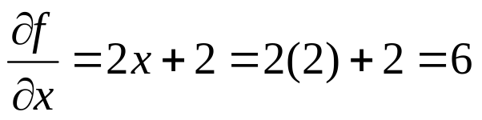
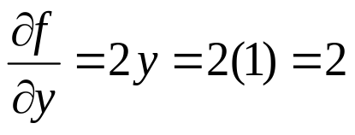
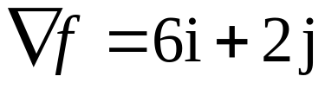

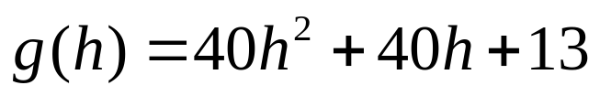
Solution
Iteration 1: To calculate the gradient; the partial derivatives must be evaluated as
Now the function can be expressed along the direction of gradient as

Slide 12


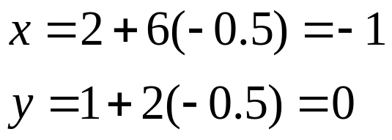
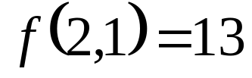

Solution Cont.
Iteration 1 continued:
This is a simple function and it is easy to determine by taking the first derivative and solving for its roots.
This means that traveling a step size of along the gradient reaches a minimum value for the function in this direction. These values are substituted back to calculate a new value for x and y as follows:
Note that

Slide 13

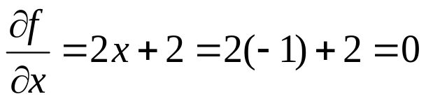
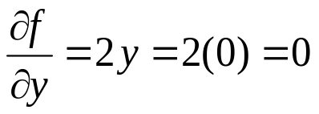

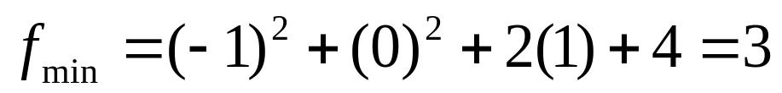
Solution Cont.
Iteration 2: The new initial point is .We calculate the gradient at this point as
This indicates that the current location is a local optimum along this gradient and no improvement can be gained by moving in any direction. The minimum of the function is at point (-1,0) and .

Slide 14
THE END

